Slide 1

Medium-Fi Prototype

Slide 2
Our mission
The current digital landscape leaves a lot to be desired for content creators and their fans.
Creators struggle to get meaningful input from their fans, and fans feel like they aren’t being heard.
creates digital studios to enable focused, productive collaboration with fans who want to contribute.

Slide 3
Tasks
Simple
Creator initializes a studio session
Fan submits an idea
Medium
Fan ranks ideas
Complex
Fans and creators discuss ideas in a room*
Notes:
*In our illustration of task flows, we break this task into two subtasks, one to illustrate the creator side and one to illustrate the fan side.

Slide 4
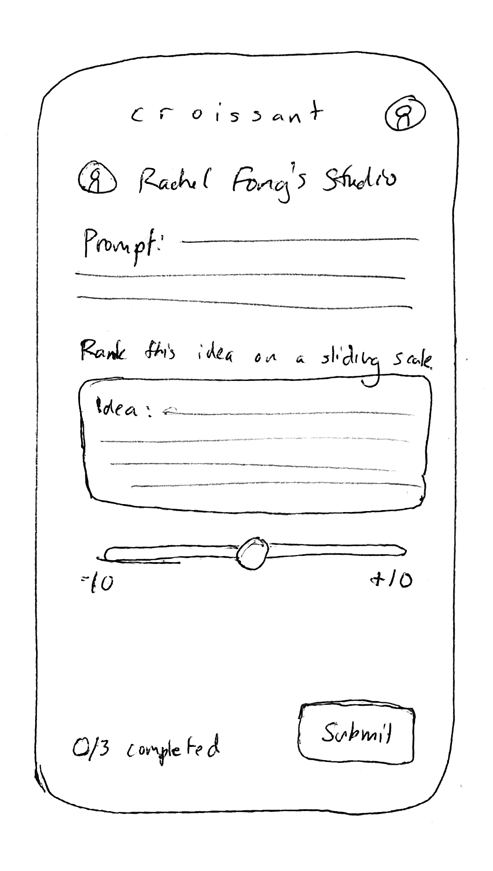
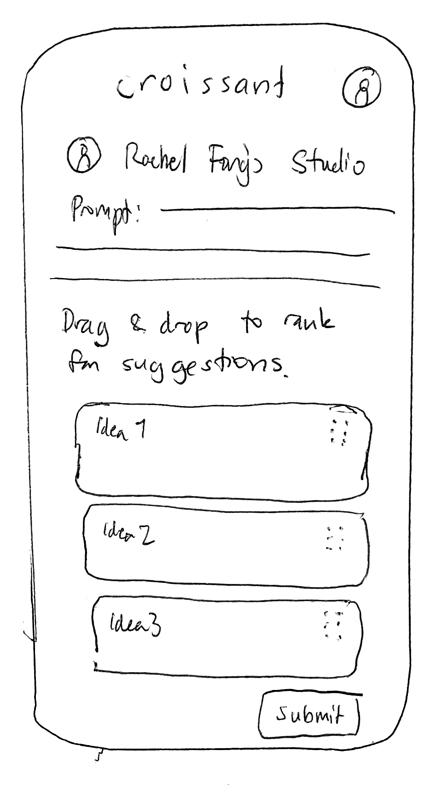
Change #1: Switch to ranking of multiple ideas
Notes:
From our feedback in the lo-fi prototype, we found that ranking up to 5 ideas was the most well-received way to prioritize fan feedback. We therefore scrapped our earlier ideas of A/B testing or sliding scale ranking to give a drag-and-drop interface for prioritizing ideas.

Slide 5
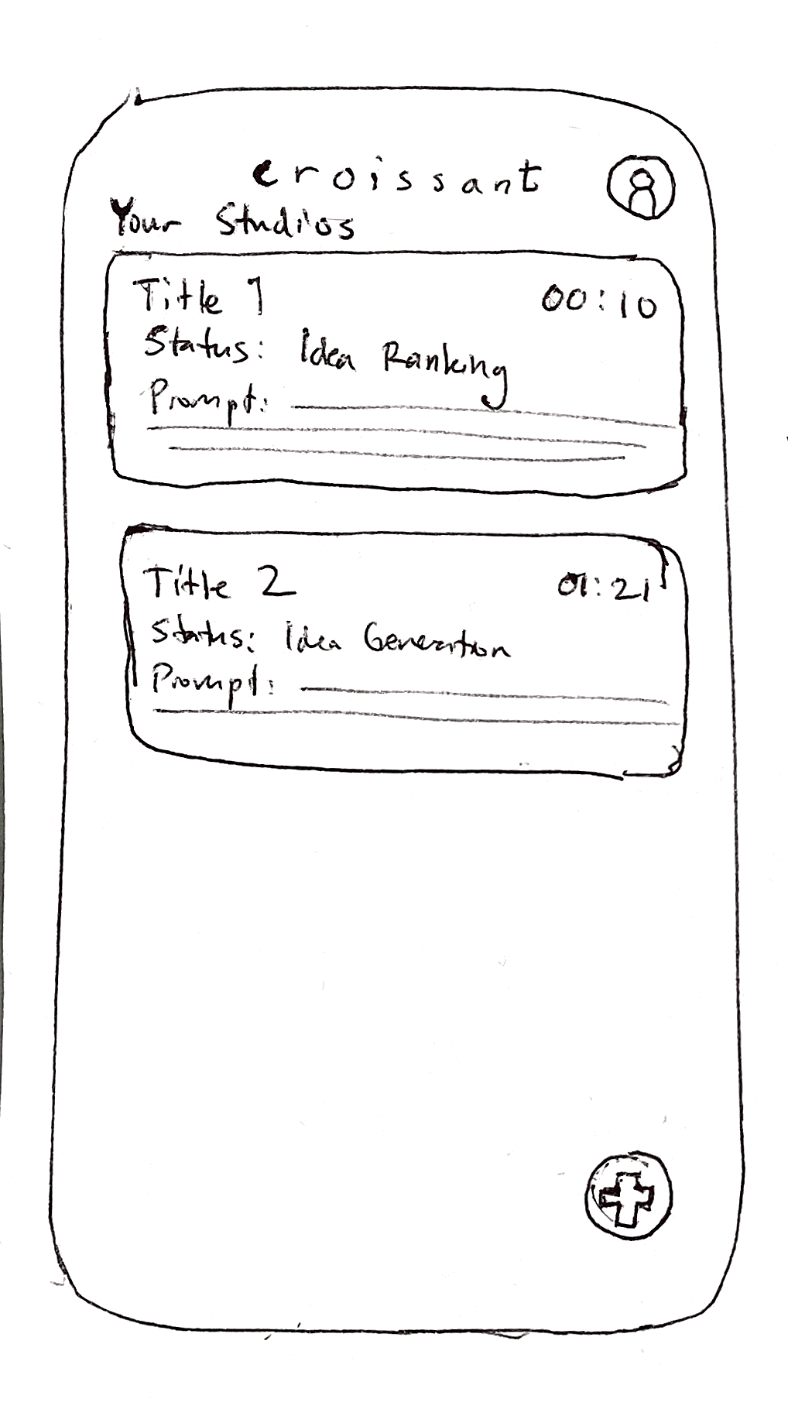
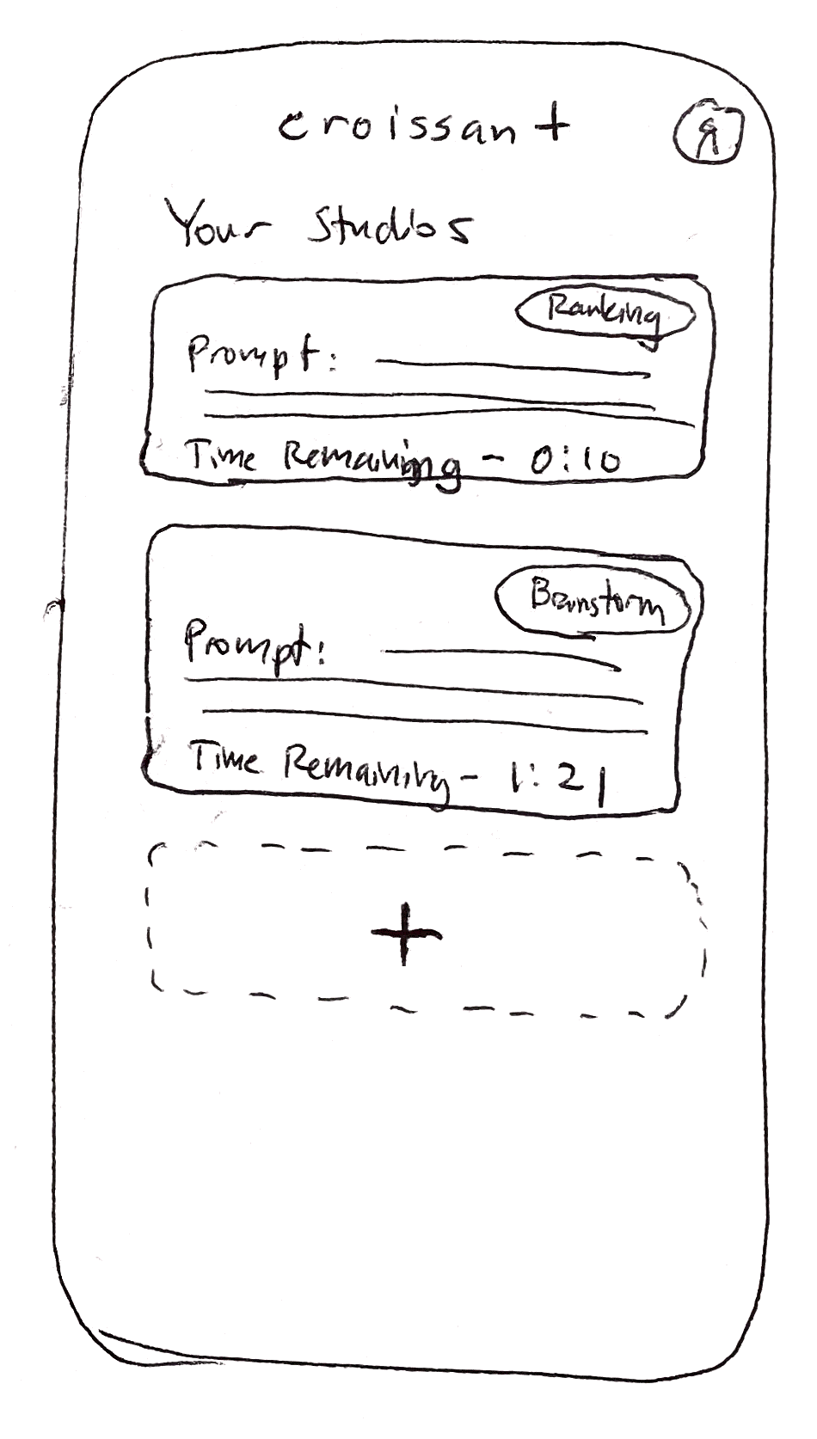
Change #2: Modifications to home feed
Notes:
One of our creator participants had difficulty finding the floating plus button. We therefore enlarged the button and put it directly under the cards to make it more visually explicit that the act of tapping that button creates a new studio. We also create badges to highlight the current status of the studio (i.e “Ranking”, “Brainstorm”), scrapped the idea of a title for the studio, and moved the time remaining indicator to a less visually salient place.

Slide 6
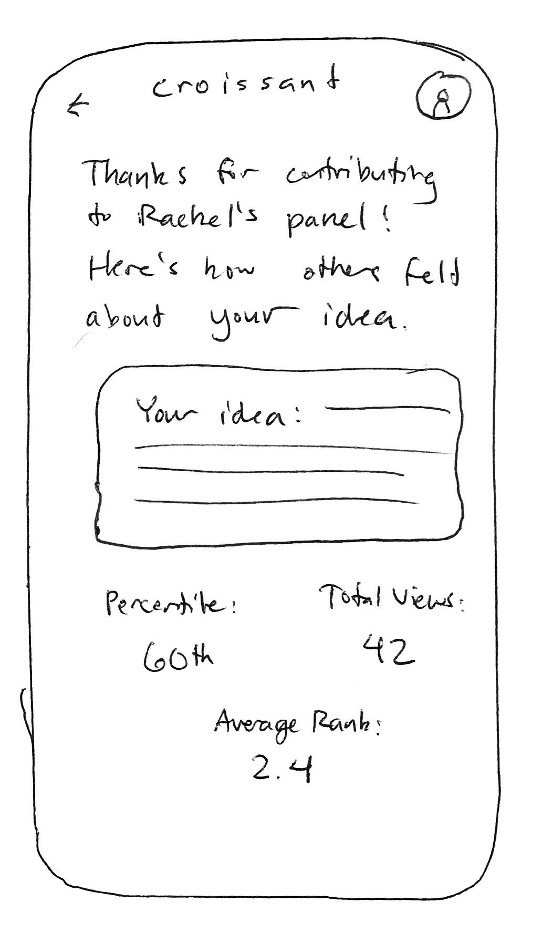
Change #3: Added recap screen
N/A
Notes:
One of our participants noted that she would feel discouraged if she submitted ideas but wasn’t selected and never heard back in any form. From that insight we came up with the idea of a recap screen, which gives fans a quick recap of how their idea performed after the brainstorm and ranking phases of a studio have finished.

Slide 7
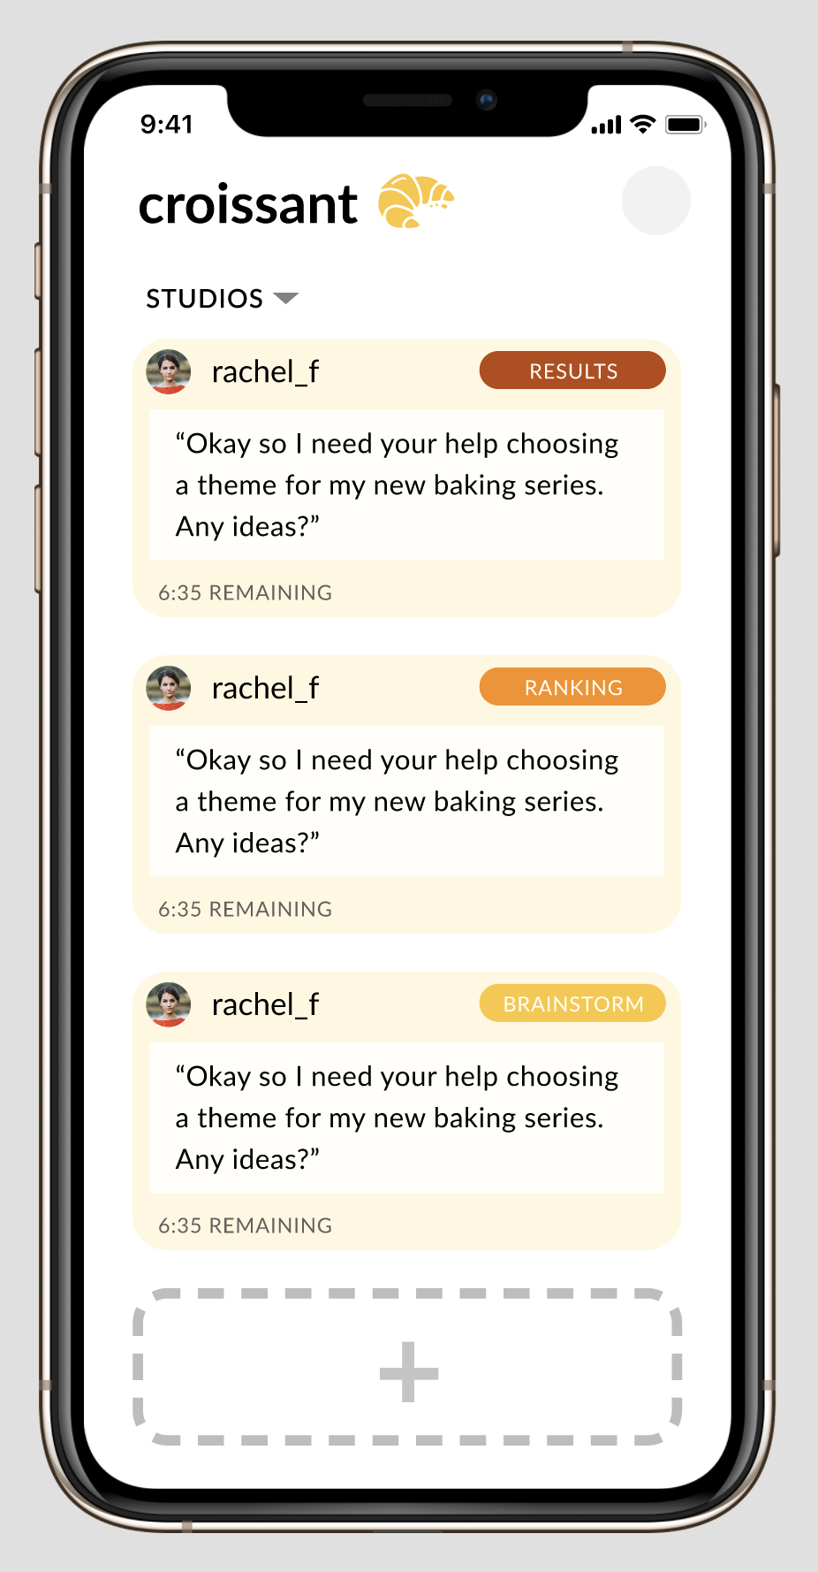
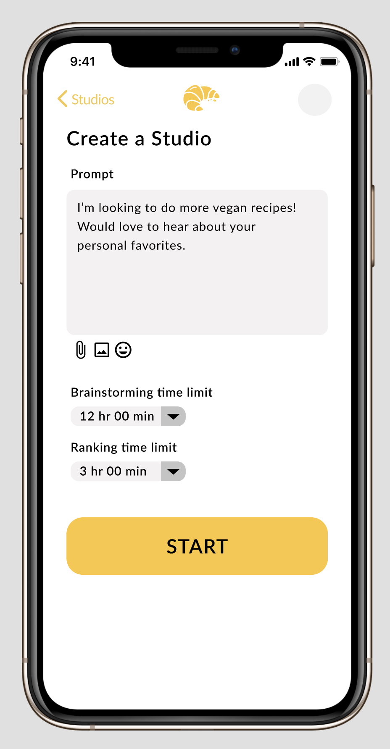
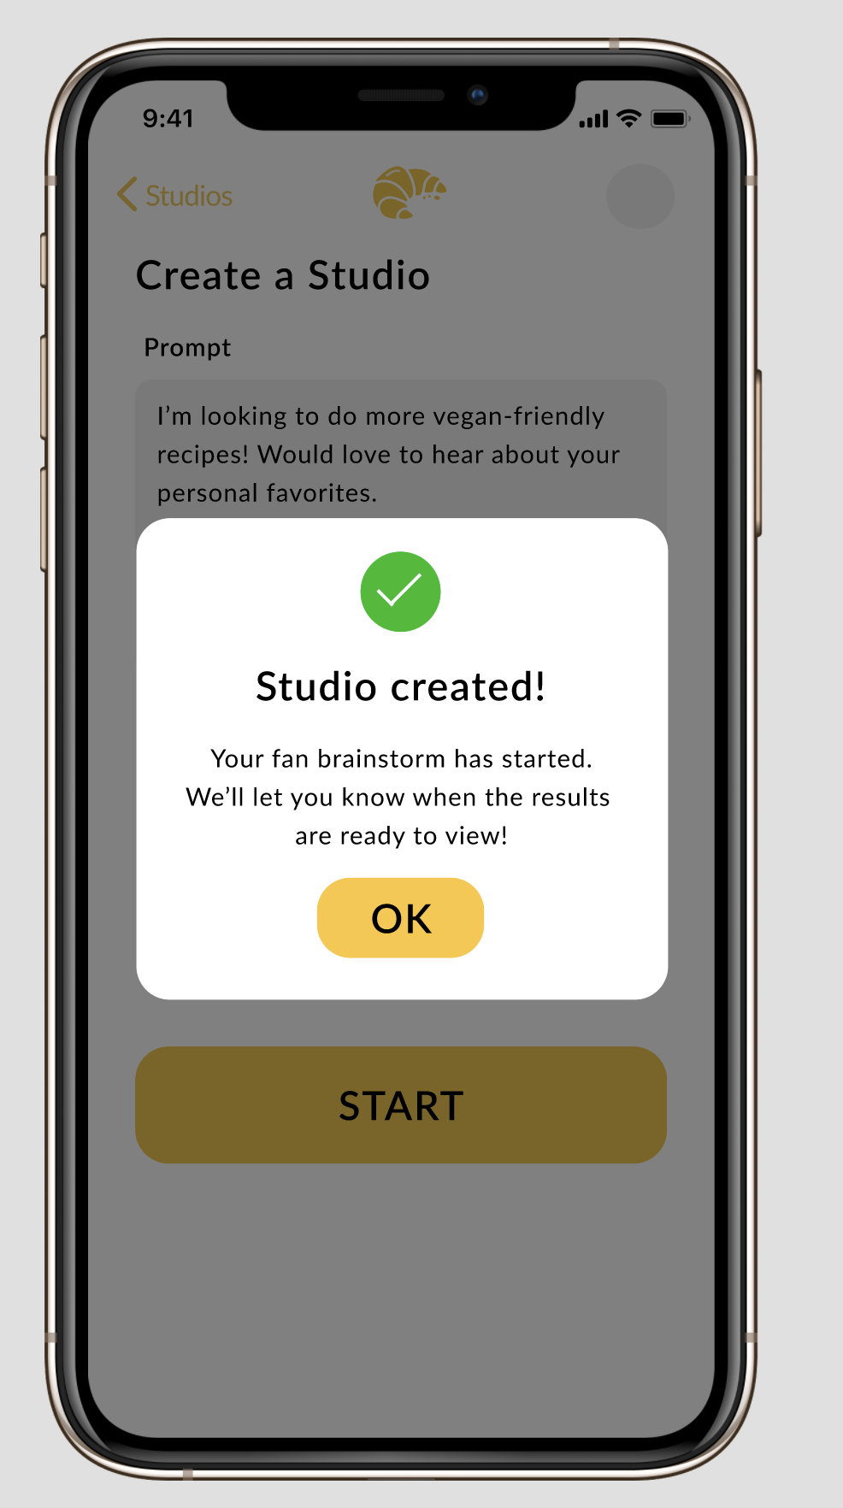
Task #1: Initialize a Studio (creator)

Slide 8
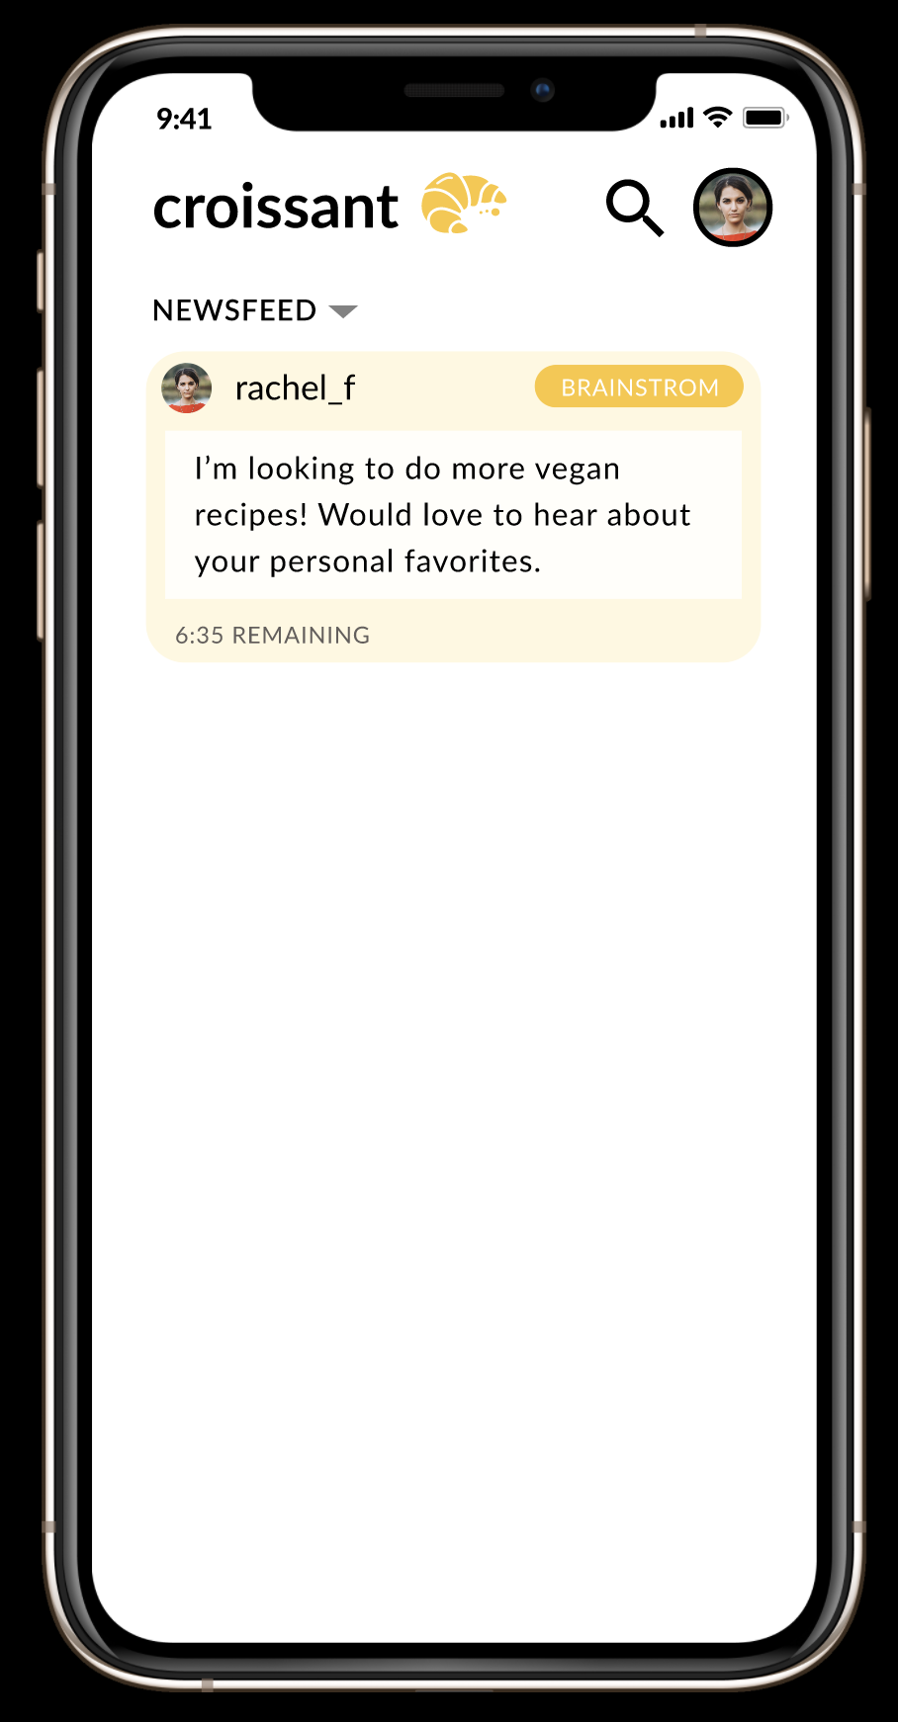
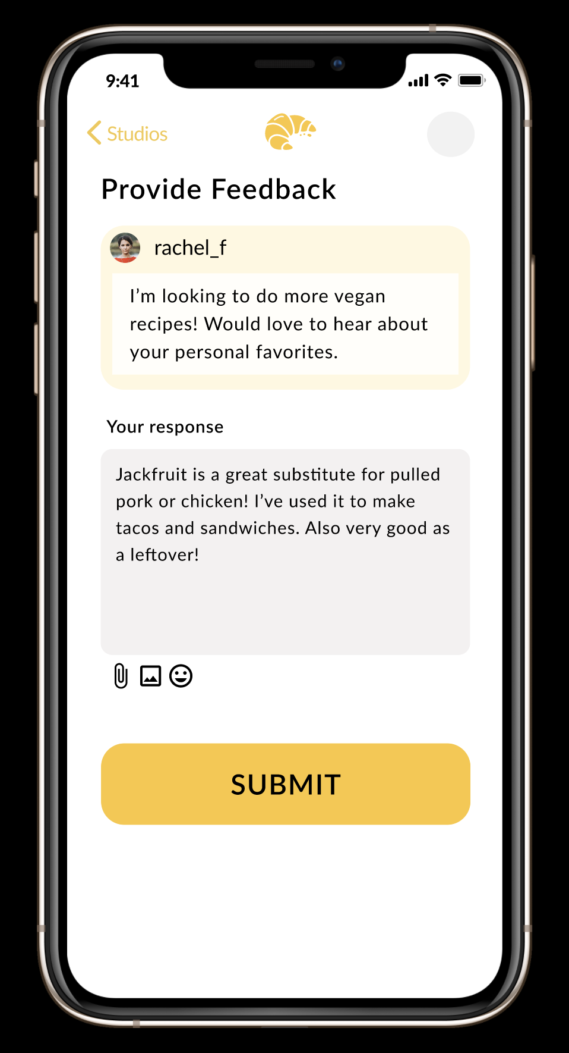
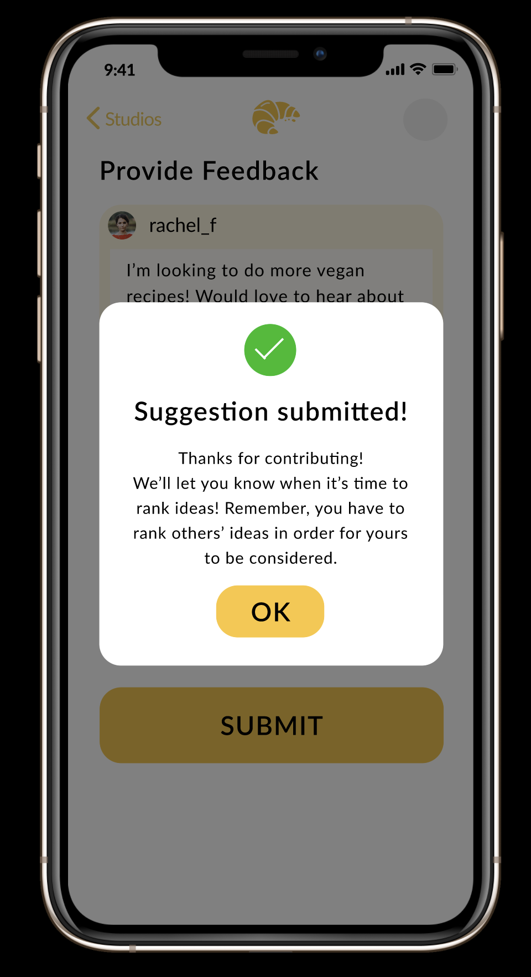
Task #2: Submit an Idea (fan)

Slide 9
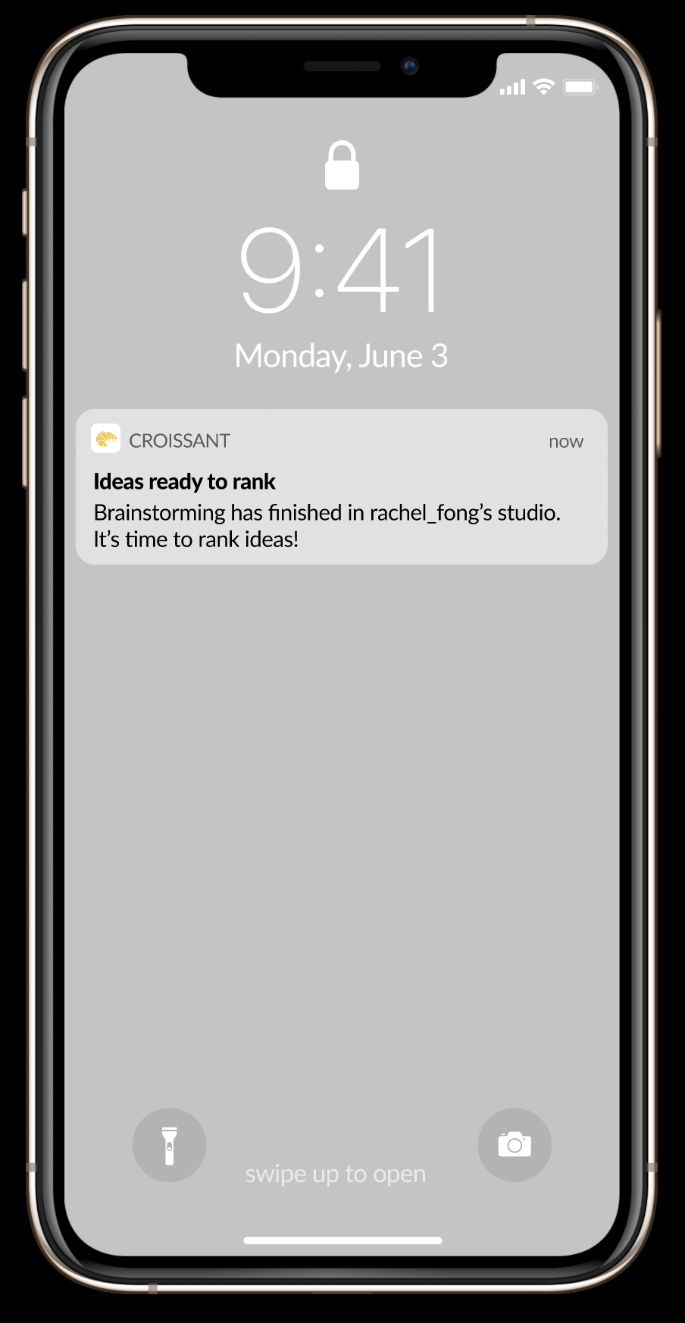
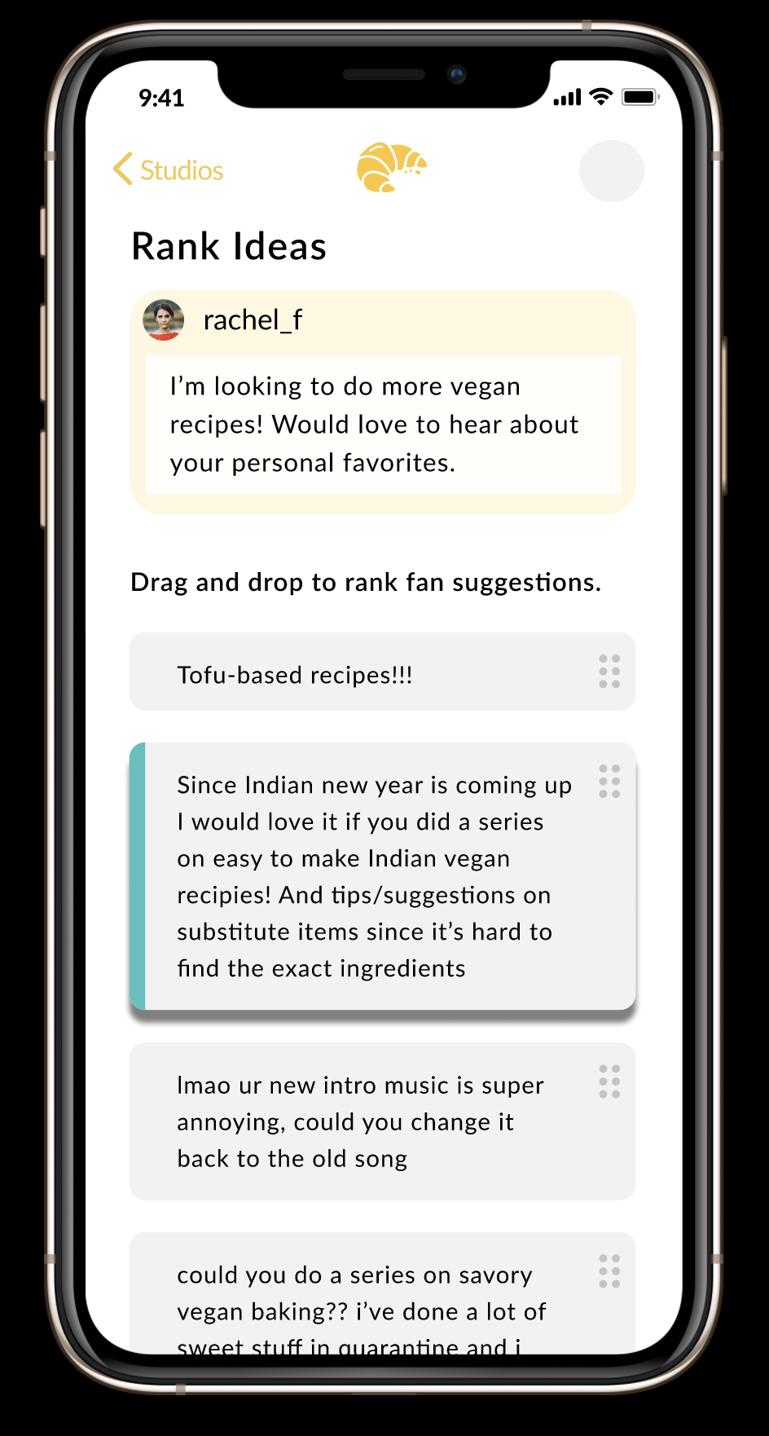
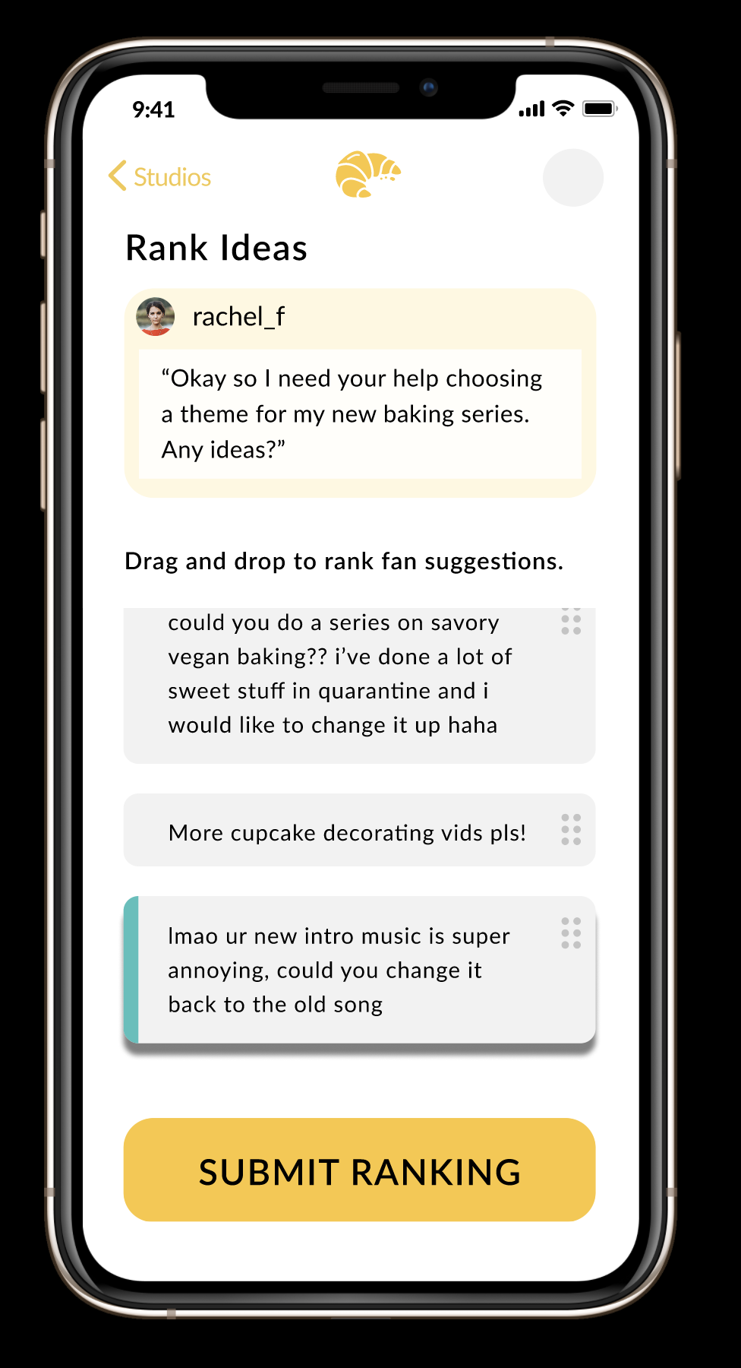
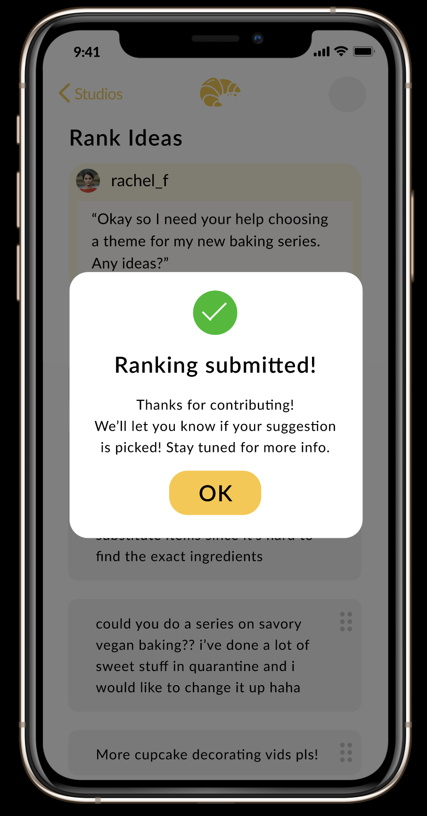
Task #3: Prioritize/Rank an Idea (fan)

Slide 10
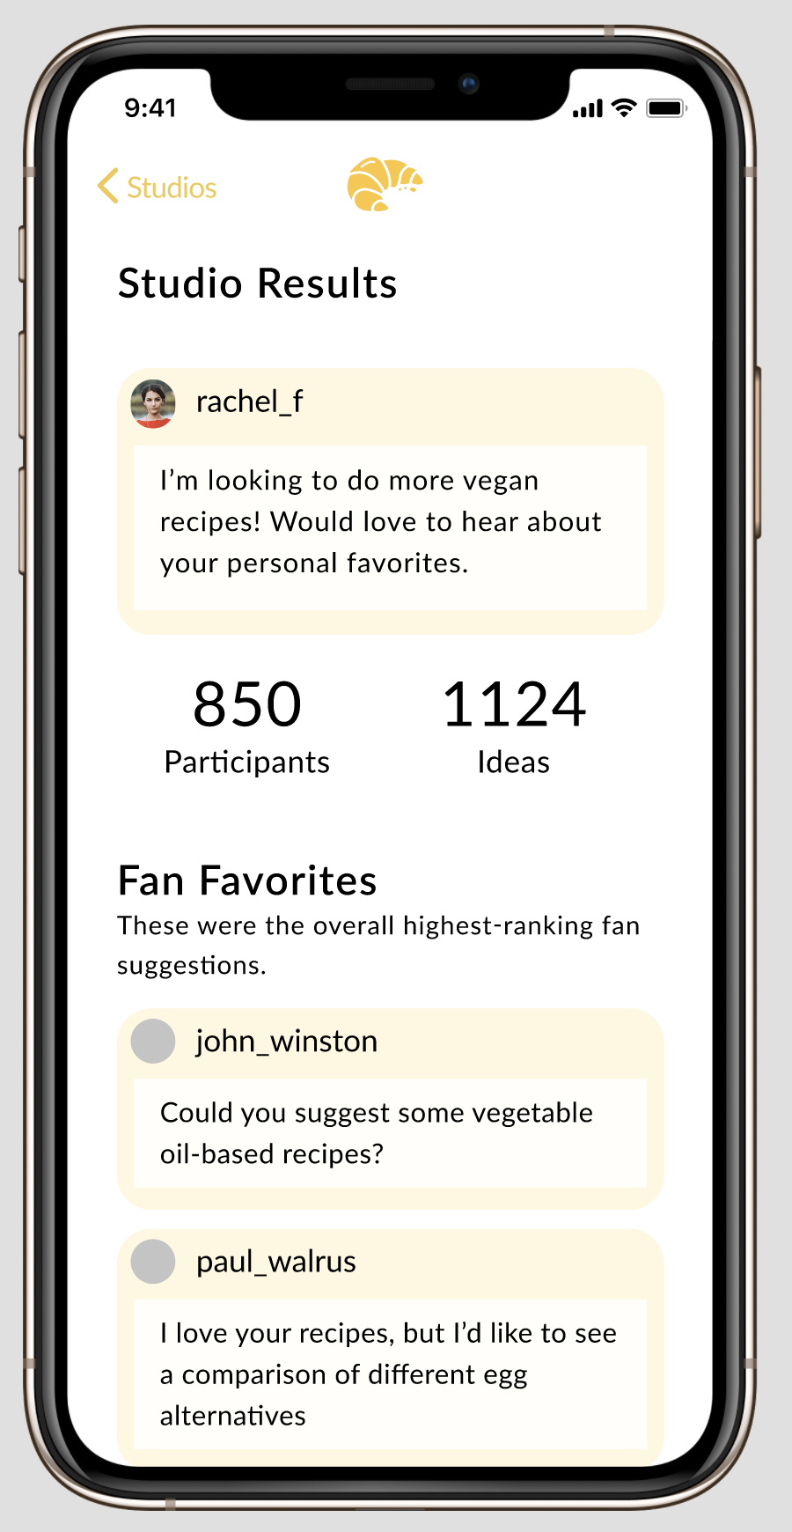
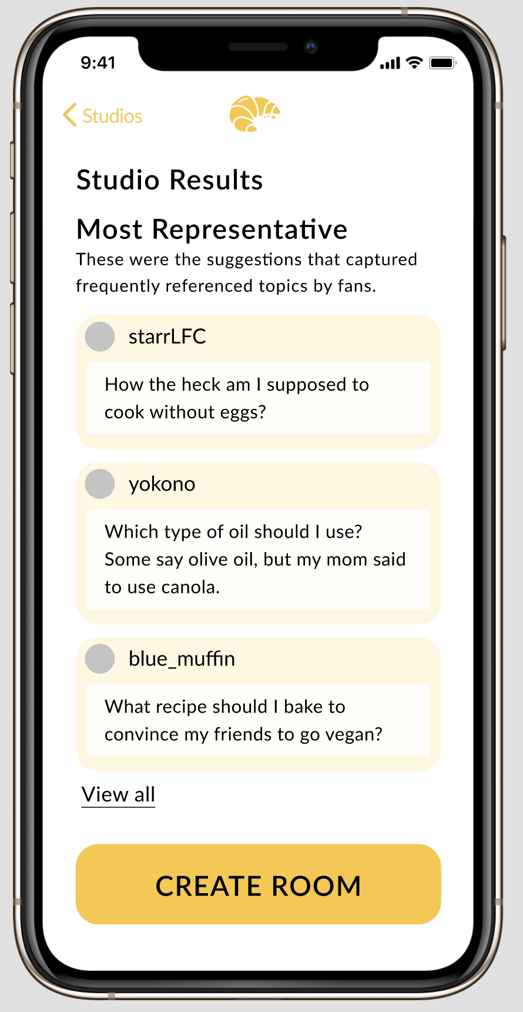
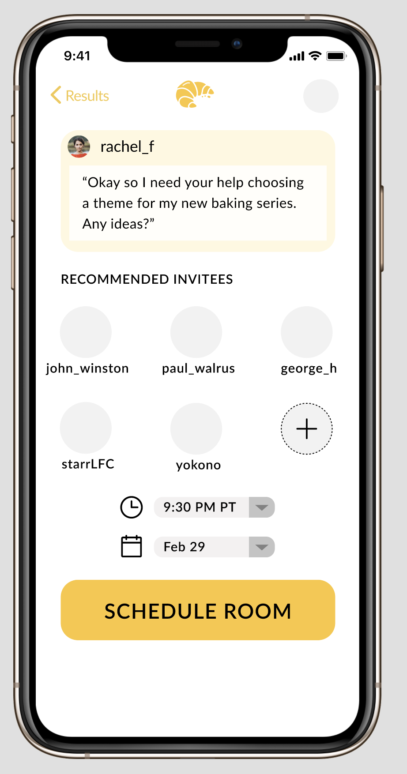
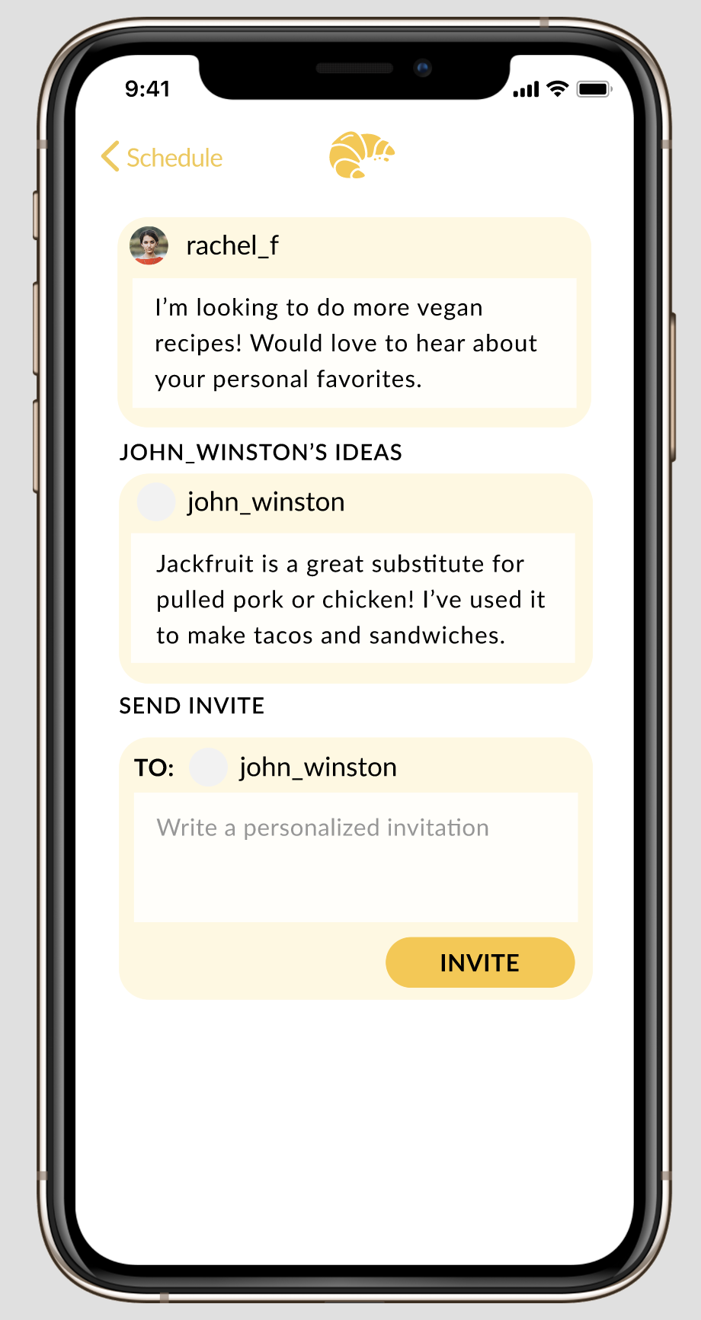
Task #4: Make + Join Panel Session (creator)
Scroll
Notes:
Frames 1 and 2 are the same screen just scrolled down below

Slide 11
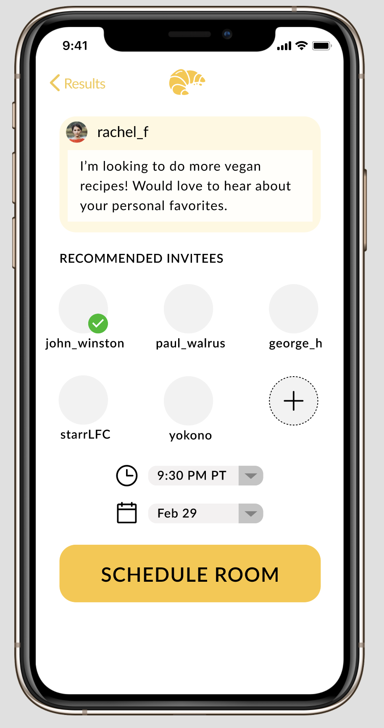
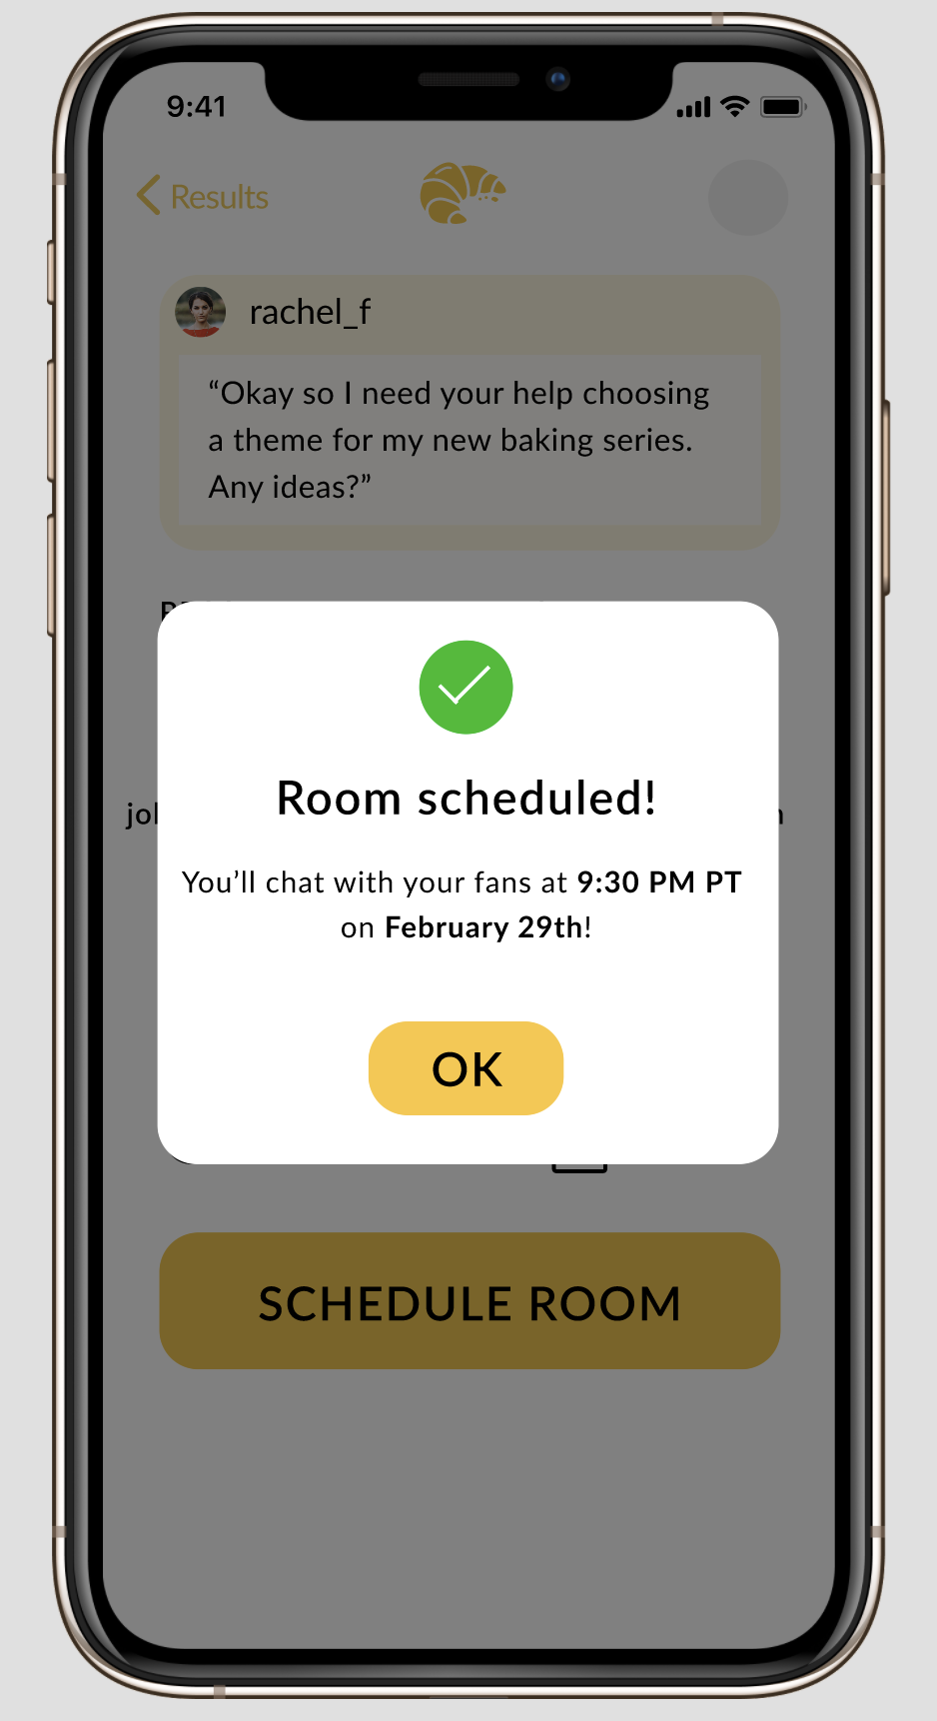
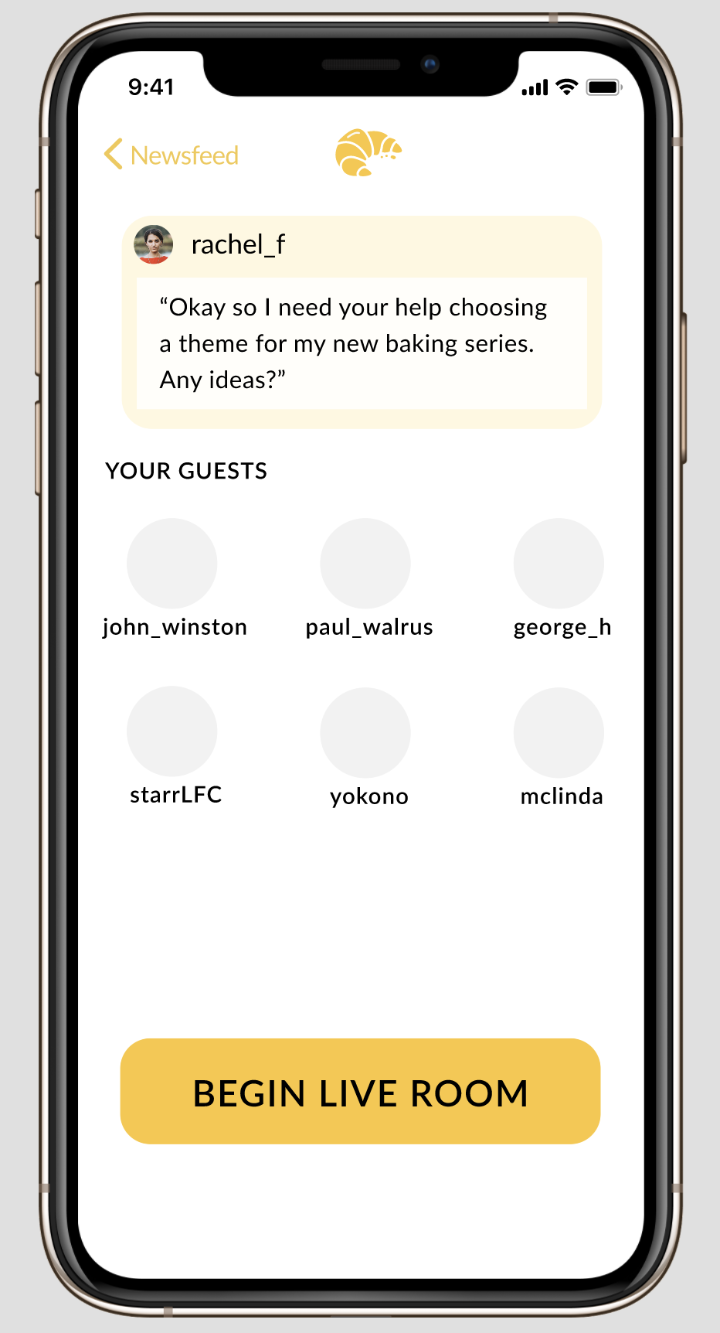
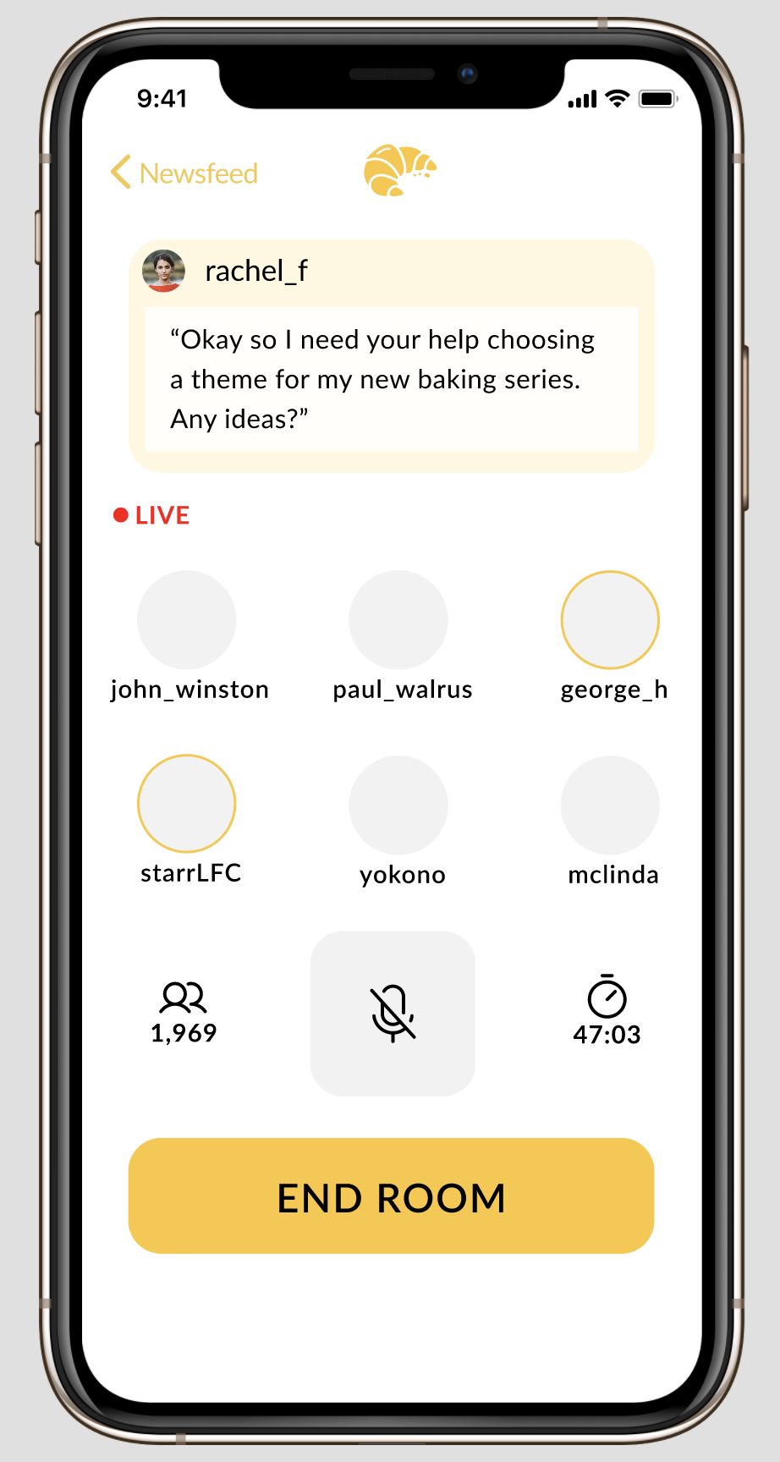

Task #4: Make + Join Panel Session (creator)
Notes:
The clock emoji represents the passage of time

Slide 12
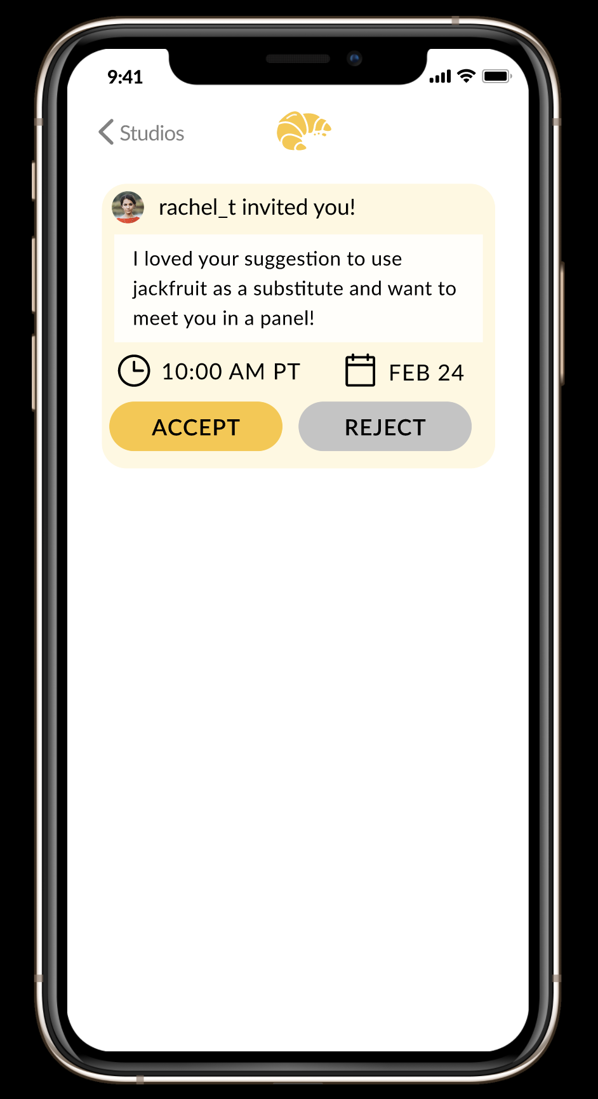
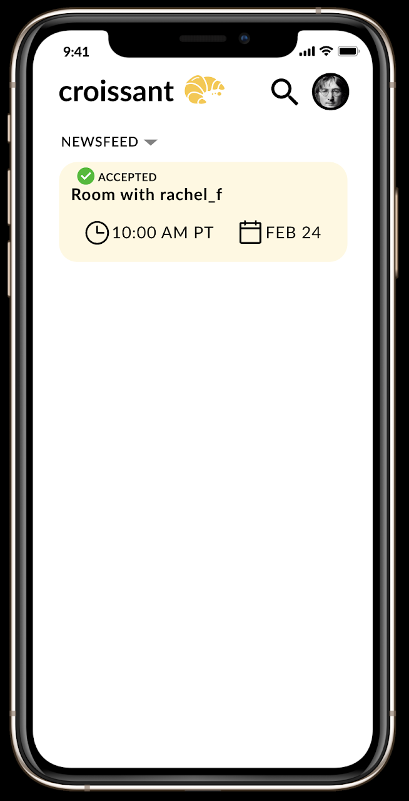
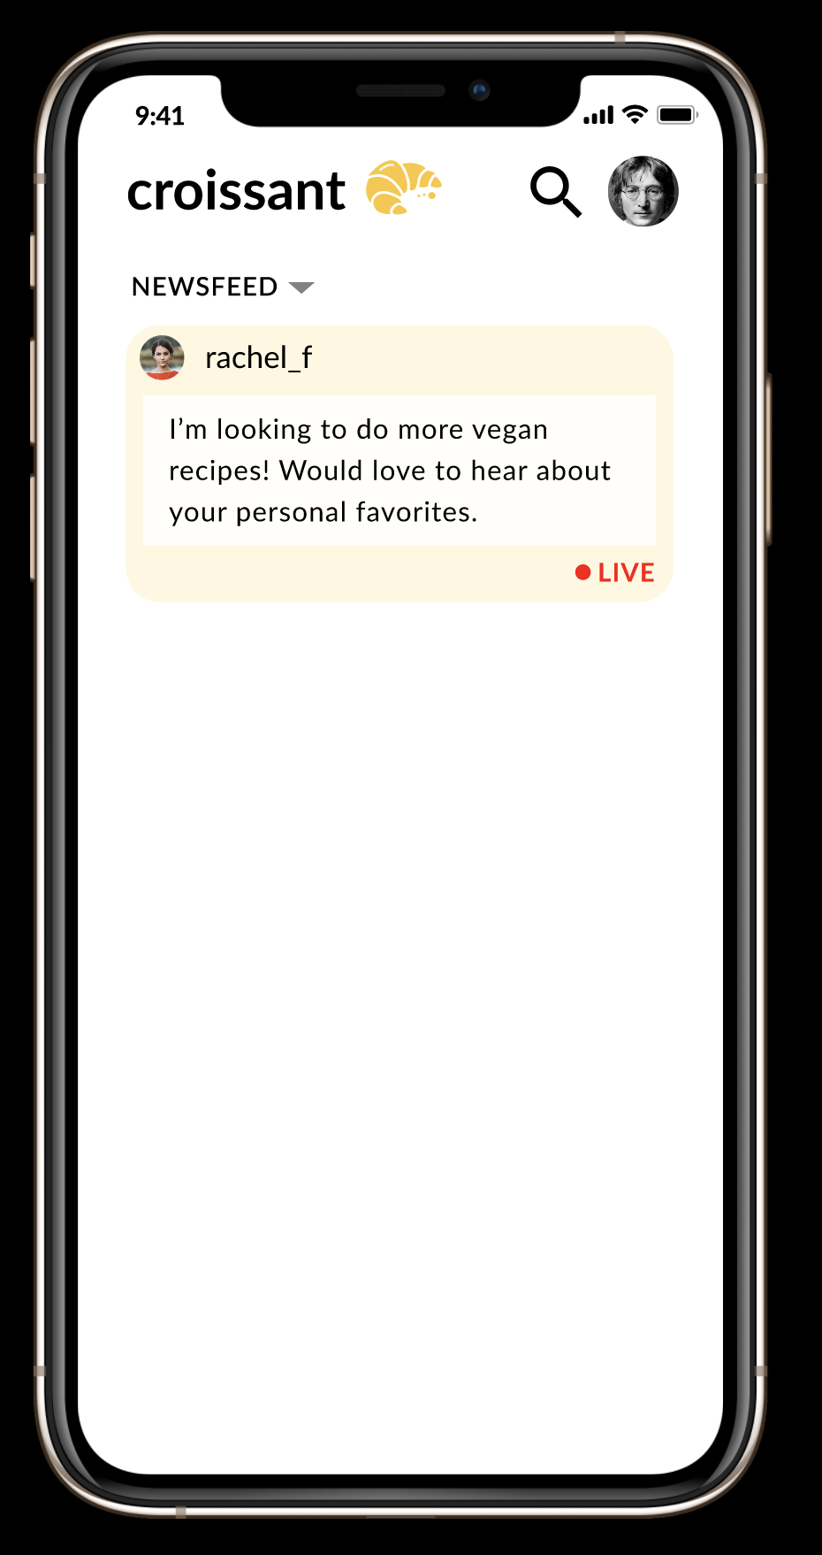
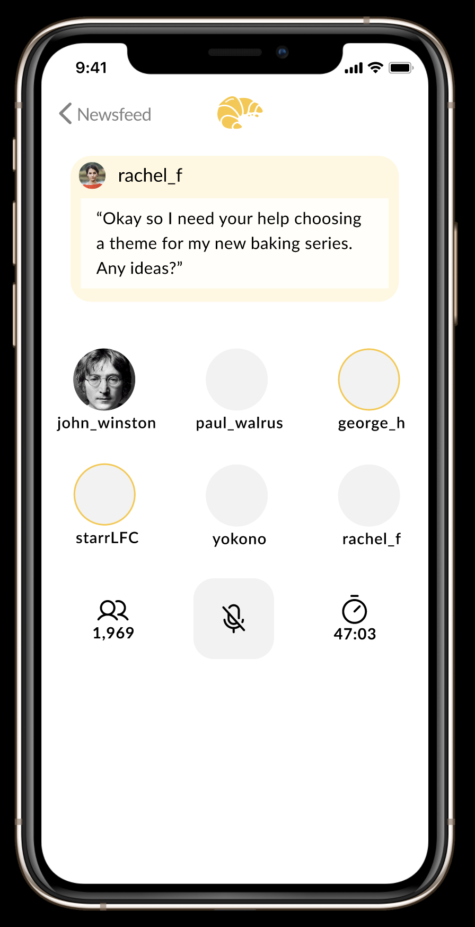
Task #5: Join Panel Session (fan)
Notes:
Again, the clock emoji represents the passage of time

Slide 13
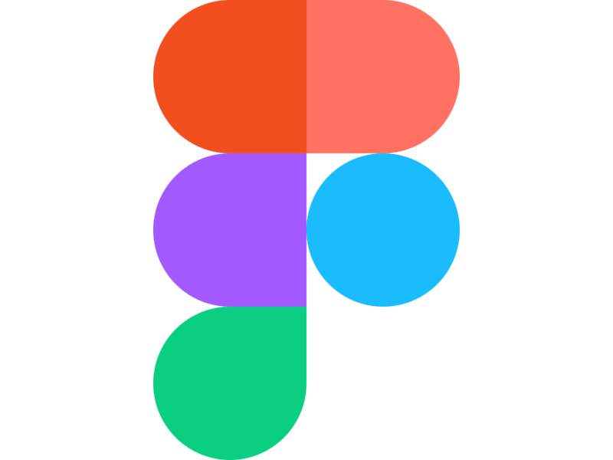
Prototype overview
We used
What was easy
What was hard
Working collaboratively
Making prototype interactive
Maintaining consistency of design between designers
Learning curve for people new to Figma
Notes:
Overall, we were satisfied with our choice of Figma. We had to put in some hours to learn the complexity of the tool. In addition, we re-doubled our use of the component system about halfway through the process as frames designed by different people had aesthetically drifted away from each other. These downsides were far outweighed by the power of Figma for designing UI elements and working collaboratively. In addition, once we completed our frames, it was easy to make the prototype interactive by linking together buttons and frames.

Slide 14
Limitations and trade-offs
Not able to simulate real-time interactions between fans and creators in a room
Not able to have custom text input (e.g. can’t actually perform search)
Limited drag and drop functionality
Notes:
The goal of our platform is to allow for fan feedback via text and creator-fan communication via the rooms. Both of those forms of custom input are not feasible in Figma, so it is a trade-off we made when deciding to use Figma. However, the purpose of the medium-fi prototype is to understand the UI more than the actual core functionality, which we have verified through needfinding and the experience prototype, so this trade-off makes sense in the context of the assignment.
A more specific limitation is that our ranking phase relies on drag-and-drop functionality, which is hard to handle via Figma. The state space is factorial in the number of ideas ranked, so we decided to force an ordering in Figma to save work.
Overall, while these limitations prevent our prototype from being a perfect model of our final product, we believe our prototype sits at the right level of fidelity between the sketches in Balsamiq and the working prototype in React Native.

Slide 15
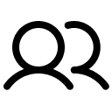

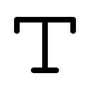
Hard-coded data
User profiles and interests
Creator prompts and fan feedback
Text entry for both creators and fans
Notes:
We addressed limitations 1 and 2 in the preceding slides by hard-coding data.
Since our platform is entirely reliant on fans and creators to generate content, we generated fake fans/creators, fake prompts and feedback, and hard-coded text-entry for flows that required it. We decided not to greek the text, as that may distract our evaluators, so we came up with realistic copy to serve as creator prompts and fan comments.

Slide 16
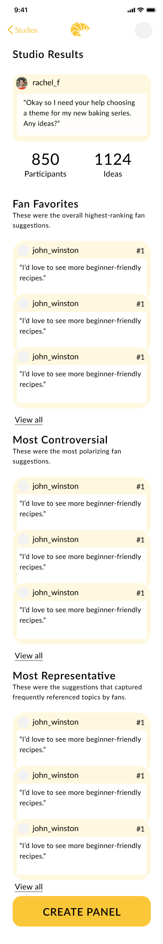
Wizard of Oz techniques
Ranking Process and Synthesis view
Time Skip
Notes:
Our summary relies on an algorithm to rank and group comments. We have hand-waved this functionality by simply writing what we think are good, controversial, and representative content
the process for a single studio takes place over days, as creators give fans hours to brainstorm and rank ideas. Therefore, we have transition screens to simulate the passage of time between different steps.

